Slide 1
Employee Attrition
Analysis and Prediction
Attrition is when employees leave their organizations for many terms such as termination, resignation, planned or voluntary retirement, long term illness and layoffs.

Slide 2
Introduction
Problem Statement
  XYZ company which was established a few years back is facing around a 15% attrition rate for a couple of years. And it's majorly affecting the company in many aspects. In order to understand why employees are leaving the company and reduce the attrition rate XYZ company has approached an HR analytics consultancy for analysing the data they have. You are playing the HR analyst role in this project and building a dashboard which can help the organization in making data-driven decisions.
Objectives of the Study
  To find gender percentage in attrition
  To find the department wise attrition
  To find the number of employee attrition by age
  To find the job satisfaction rating for specific job role
  To find Education field wise attrition
  To find the Attrition rate by gender for different Age groups
2

Slide 3
The Process
Data Collection
Data Cleaning
Data Analysis
Model Performance
Insights
Summary
3

Slide 4
Data Collection
The Data has been collected in the form of a CSV file named “Employee Attrition Data.csv”.
The CSV file has the data of attrition of employees with comparison to their age, gender, education level and other variables.
4

Slide 5
Data Cleaning
There were 111 Null values or blank fields
We imputed the null values by the forward fill method by using the median values of the respective columns.
Values in ‘Attrition’ column is in String datatype. So we converted them to Integer datatype using Python
Dropped the 'Standard_Hours', 'Employee_Count', and 'Over18' columns from the dataset.
5

Slide 6
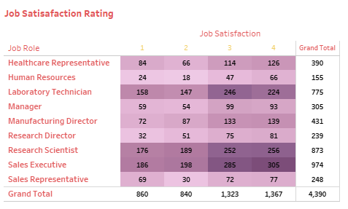





Data Analysis
6

Slide 7
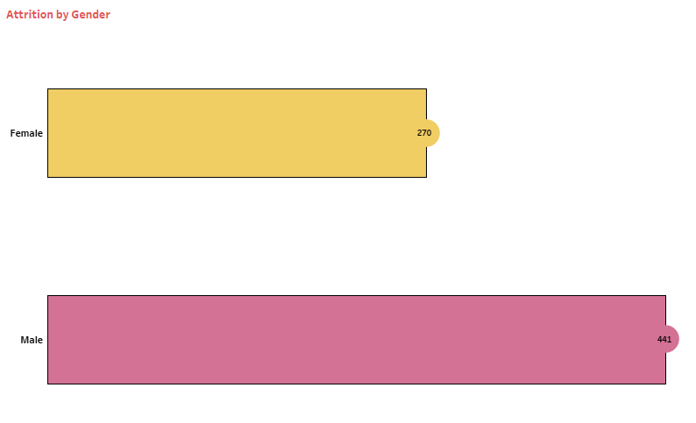
Data Analysis
Attrition by Gender
7

Slide 8
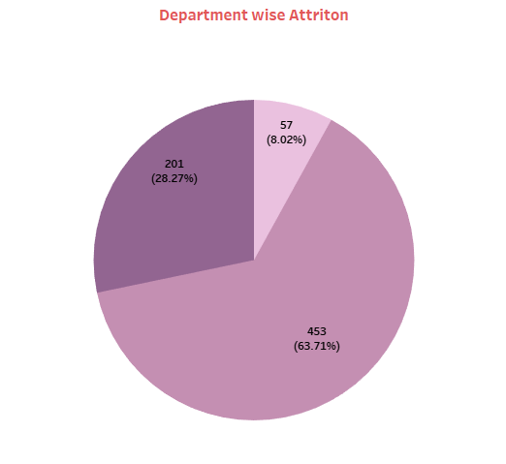

Data Analysis
Department wise Attrition
8

Slide 9
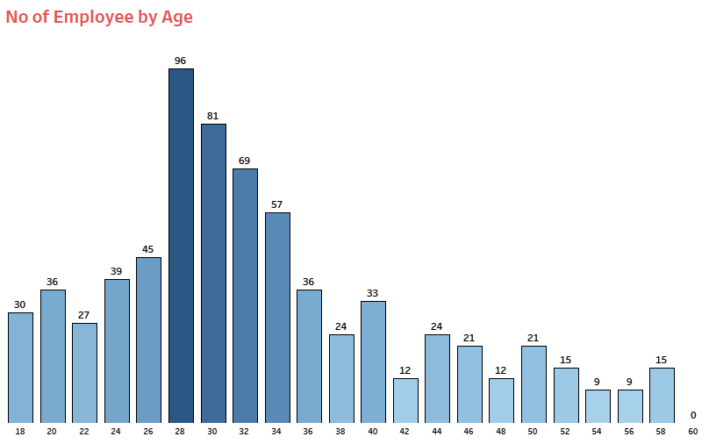

Data Analysis

Slide 10
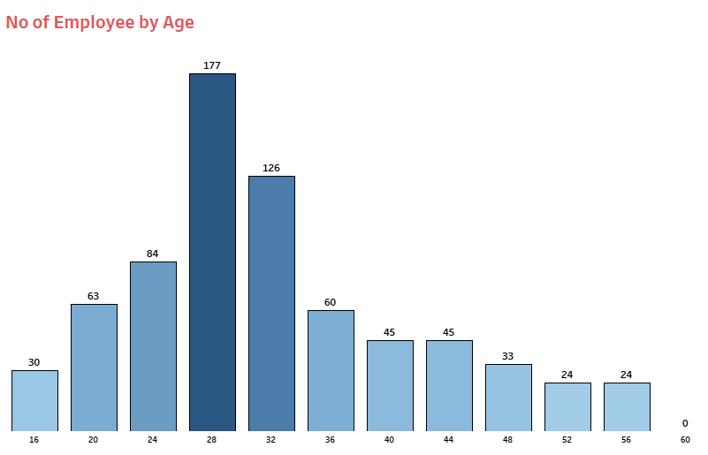
Data Analysis

Slide 11
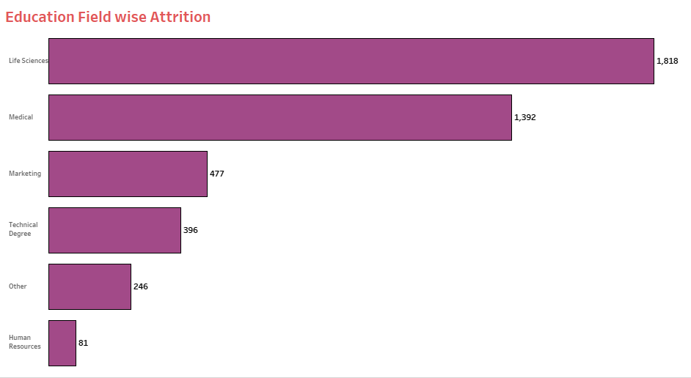
Data Analysis

Slide 12
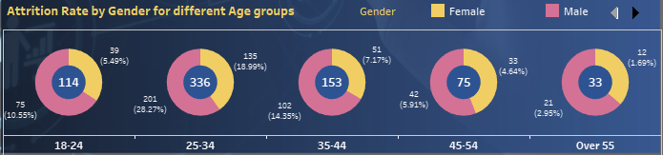
Data Analysis

Slide 13
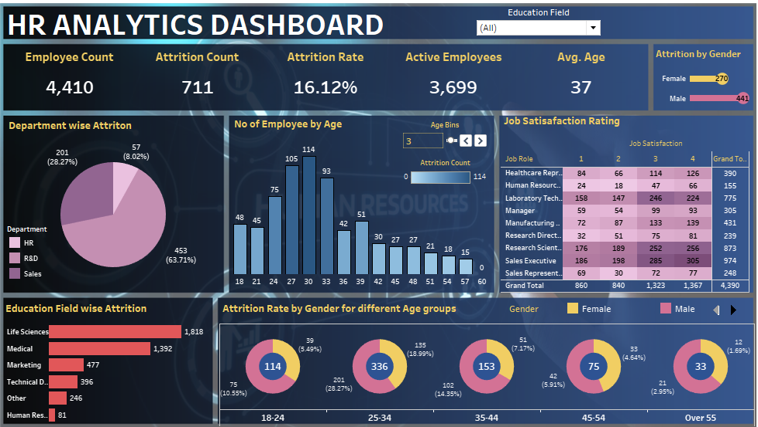
Data Analysis

Slide 14
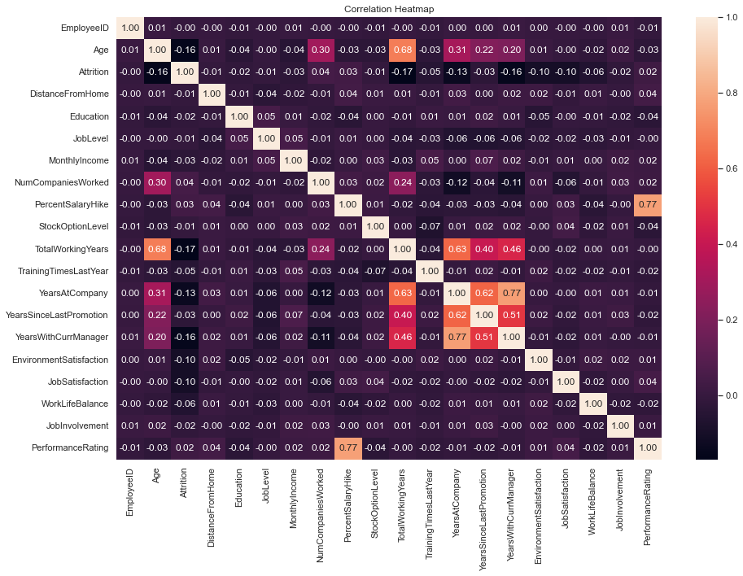
Data Analysis

Slide 15
Data Analysis
(1) 'Total_Working_Years', 'Age' (correlation=0.68)
(2) 'Percent_Salary_Hike', 'Performance_Rating' (correlation=0.77)
(3) 'Years_At_Company', 'Years_With_Curr_Manager' (correlation=0.77)
All these variables have moderate to high correlation with each other. These variables should be removed from the dataset by analyzing the Variation Inflation Factor of the variables or they might affect the accuracy and prediction of the ML model.

Slide 16
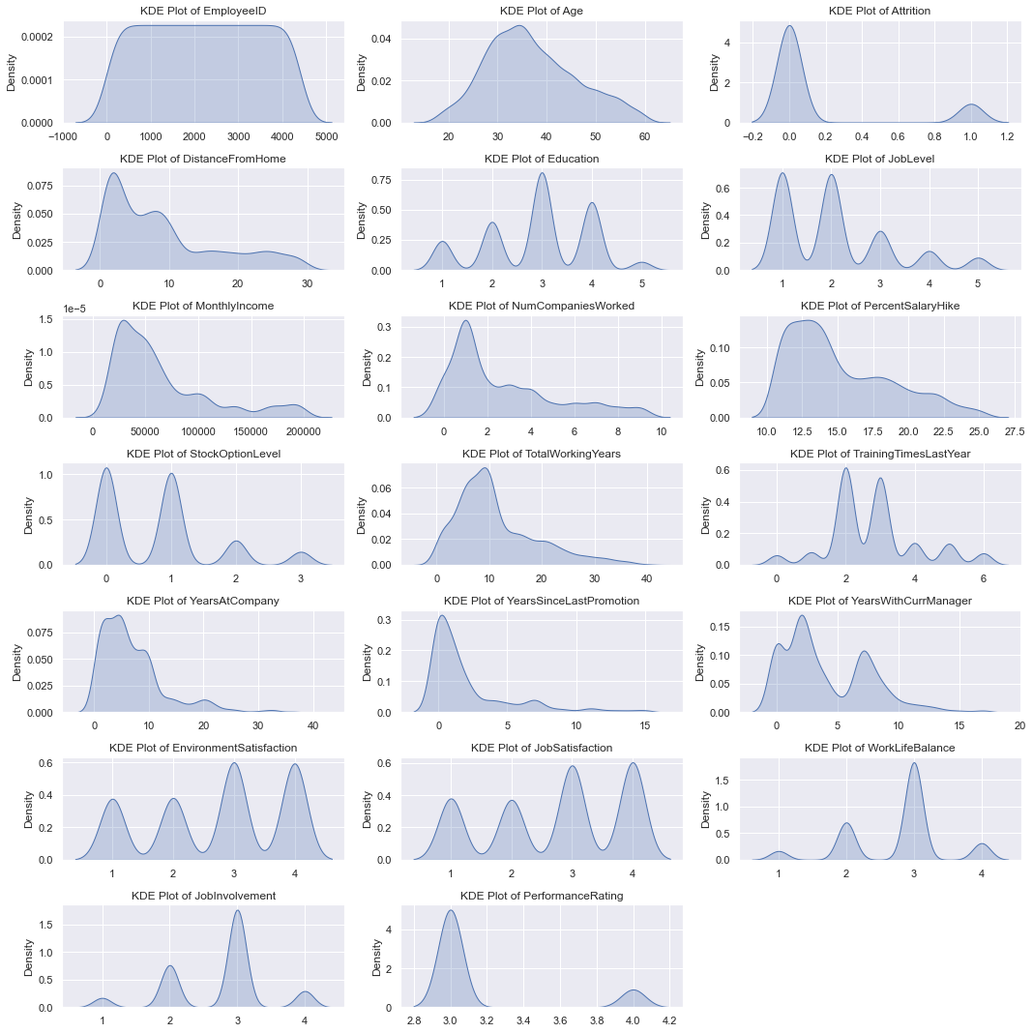
Data Analysis

Slide 17
Data Analysis
KDE Plot of 'Years_with_curr_Manager' follows a bimodal distribution.
KDE Plot of 'Age', 'Distance_From_Home', 'Monthly_Income', 'Num_Companies_Worked', 'Percent_Salary_Hike',
'Total_Working_Years', 'Years_At_Company',
'Years_Since_Last_Promotion' have a left skewed distribution.

Slide 18
Model Performance
We performed the encoding and scaling of the features to ease the machine learning model for better prediction.
We scaled the features using Standard Scaler from the sklearn library of Python.
'Department_Sales' is a collinear feature which means it has a high correlation, hence we dropped this feature to remove the multicollinearity issue.

Slide 19
Model Performance
We split this data into training and testing data in the ratio of 80:20 that is 80 percent of the data is training data and the rest 20 percent is testing data.
XG Boost model will train on the training data to provide predictions on the testing data.
The target column is the 'Attrition' column that is this column is to be predicted.

Slide 20
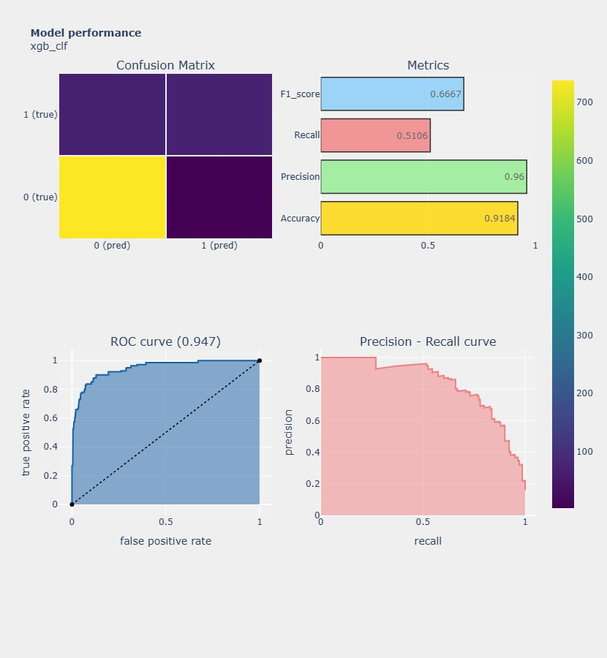
Model Performance

Slide 21
Model Performance
After training the XG Boost model and putting it to test, we got an accuracy of 91.84 percent.
The True Positives, True negatives, False Positives and False Negatives are 72, 738, 3 and 69 respectively.
Here the most important metric is Precision which is determined by the False Negatives. So we got a good precision value which will give us better results about the prediction.

Slide 22
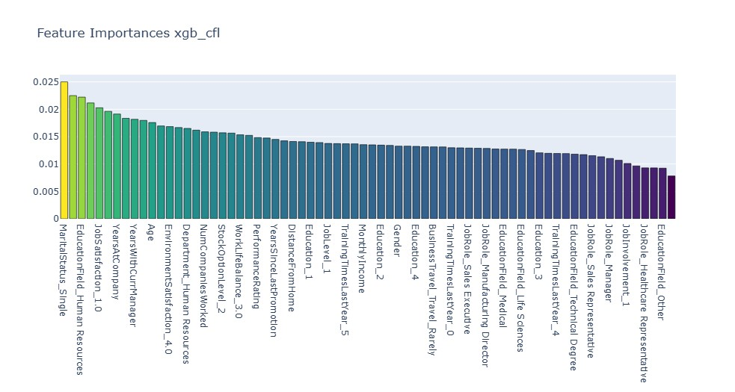
Model Performance

Slide 23
Model Performance
The previous figure shows that Marital Status is the feature of the highest importance followed by Education Field HR, Job Satisfaction, Years At Company and so on.

Slide 24
Insights
The attrition rate for the company is around 16 percent.
Most of the employee attrition is around the age of 25 to 34 years.
Number of male attrition in the company is double that of the number of female attrition in the company.
There are around 1700 employees who gave low ratings ( 1 star and 2 star) in Job Satisfaction Form. This shows that they were unsatisfied with their respective jobs.

Slide 25
Insights
Most of the employee attrition were from the Research and Development department followed by Sales and Human Resources department.
Around 3200 of the employee attrition are from Life Sciences and Medical field.
The number of employee attrition between the ages 24-35 is 396 out of which 201 are males and 135 are females.

Slide 26
Summary
Understanding the causes of attrition is the most important; Conduct exit interviews to gather information on why the employees are leaving.
Providing additional perks to the employees such as health and wellness, retirement plans, performance bonus and benefits.
Foster a positive, supportive and healthy work culture within the company.
Ensure that management practises are fair and managers are trained in effective leadership.

Slide 27
Summary
Promote good work life balance through flexible work schedules and remote work options.
Establish programs to recognize and reward employees for their contributions and achievements.
Conduct regular job satisfaction surveys to identify areas of improvement and act on the feedback accordingly.
Provide resources for mental health and stress management.

Slide 28
Thank you

